Slide 1
R2 – Iteration 3
Use Case Diagram

Slide 2
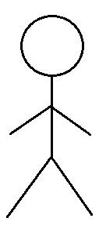
Carriage
Use Case Diagram (I3)
Module 5 - Shopping Cart
Use Case Diagram (I3)
05.02 Manage Orders(make edits)
05.03 Cancel order
Register
Stores
05.07 Generate receipts
Register
Customers
User
Support
Team
05.08 Checkout Order

Slide 3
R2 – Iteration 4
Use Case Diagram

Slide 4
Carriage
Use Case Diagram (I4)
Module 3 – End-User Account
Use Case Diagram (I4)
03.09 Review order history
03.11 Upgrade to member account
Register
Customers
03.12 Downgrade from member account

Slide 5
Carriage
Use Case Diagram (I4)
Module 5 – Shopping Cart
Use Case Diagram (I4)
05.01 Track items for orders
Register
Customers
Register
Stores
05.04 Bookmark an item
05.05 Save store to favorites
Delivery
Management
Representative
User
Support
Team

